Slide 1
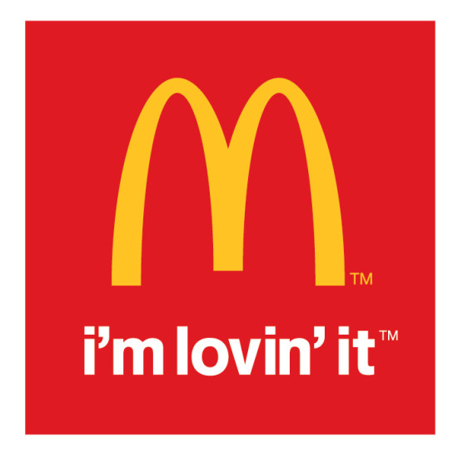
McDonald’s Corp. Company Evaluation
Wednesday, July 12, 2018
Chandler Rohde, Fanta Ballo, Joseph Ramesar, Jared Finkle, Zara Saldanha, Jayce Kim

Slide 2
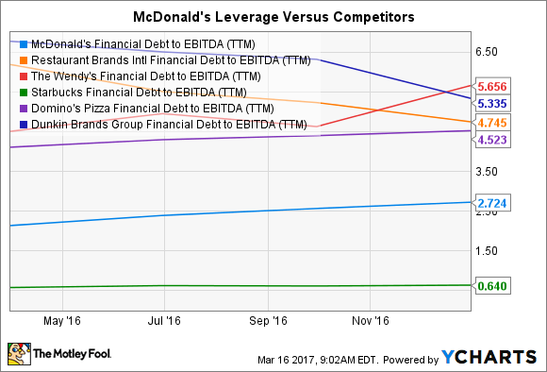
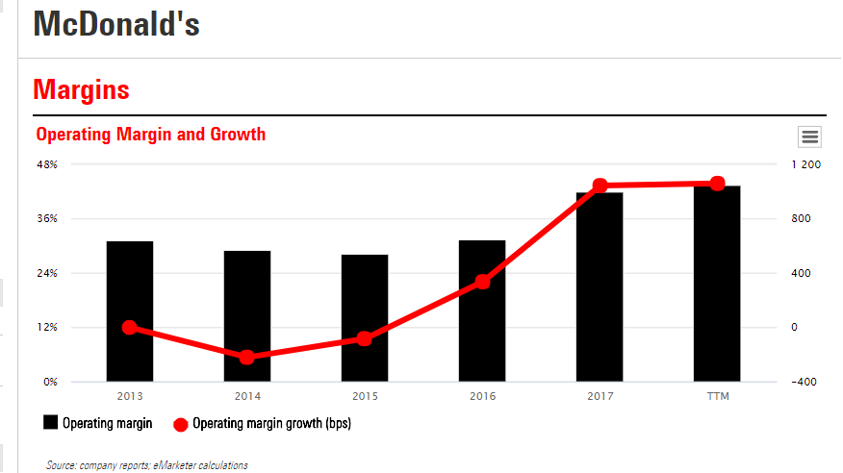
Investment Thesis
McDonalds Corp (NYSE: MCD)
OVERWEIGHT
While having one of the farthest reaching brand images and global presences alone has not been enough over the last half decade to keep pace with changing demographic behaviors and outlooks on fast-food, MCD has not sat idly by. A global, top-down restructuring initiative coupled with forward-thinking financial leveraging, brand reimaging and marketplace innovation have done more than just keep the fast-food giant afloat. MCD is well-positioned to defend its sizable market share and drive long-term growth.
Refranchising Effort: As part of CEO Steve Easterbrook’s company turnaround program, more than 91% of McDonald’s locations are franchised (Dec 2017), with the goal being 95% in the next few years.
Increased Cash Flows and Earnings, lower CapEx and Operating Costs
Debt Increase- Stock Repurchasing and Div. Payouts: Though MCD saw its debt burden increase by 62% in 2015 from the previous year, this was a leveraging tactic meant to drive value and return capital to investors.
Dividend yield has increased steadily, ROIC to WACC suggests value is being created rather than diminished, and any potential losses can be mitigated by substantially increased cash flows that serve as risk-insulation.
Brand Reimaging and Innovation: With the continued rollout of Experience of the Future Initiatives globally (kiosks, table service, etc.), Fresh Beef and Premium Items, successful initial delivery service with UberEats, MCD mobile app, etc., the company has directly responded to growing consumer preferences for fast-casual and more socially responsible dining experiences.
INVESTMENT THESIS

Slide 3
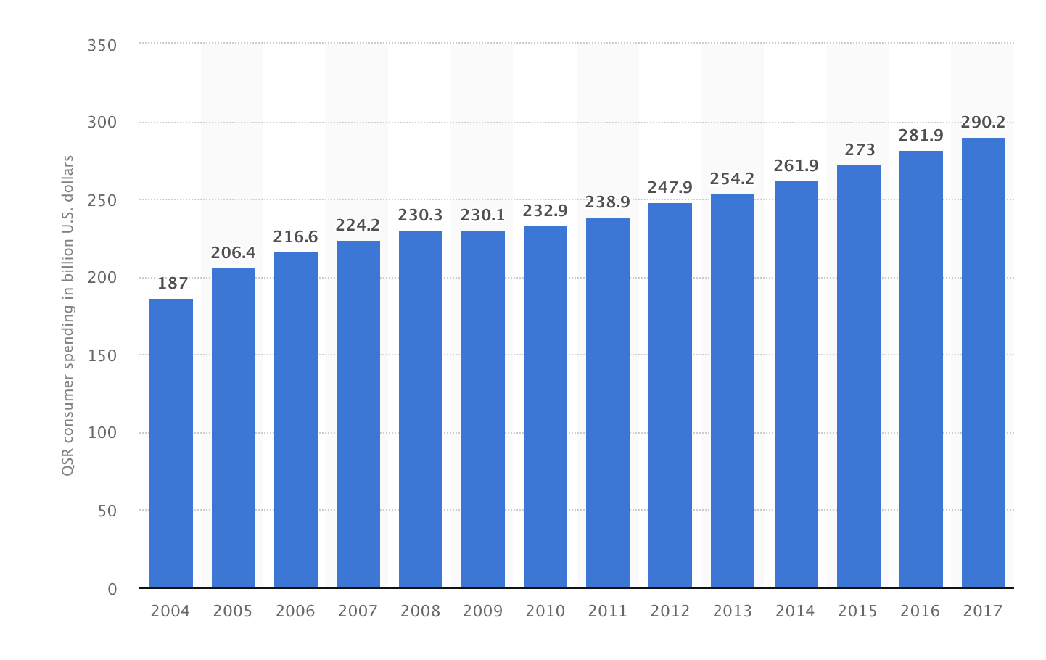
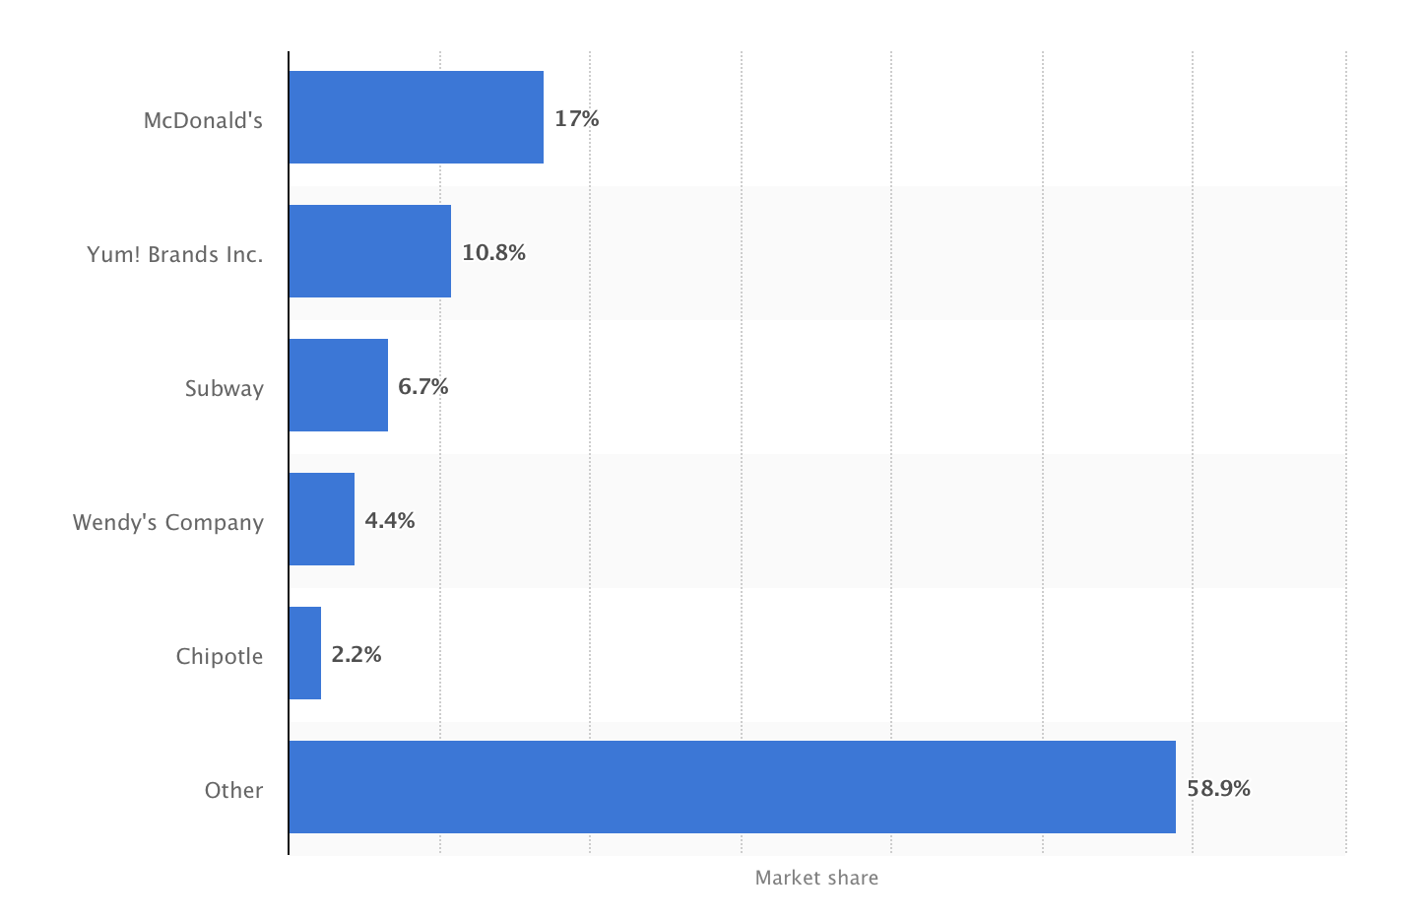
Industry Overview: Fast Food
McDonalds Corp (NYSE: MCD)
Revenue
$255bn
Annual Growth ‘13-’18
3.8%
US has the largest fast food industry in the world
highly fragmented: the 50 largest companies account for about 20% of revenue
Low barriers to entry, but high risk/return
Overall trend towards healthier eating
Investing and introducing healthier options
Diversifying menu options for international markets
Low prices, convenience, many locations
QSR industry in US includes about 270,000 restaurant
Most QSR establishments specialize in a particular type of cuisine
Hamburger restaurants account for about 40%
INDUSTRY OVERVIEW

Slide 4
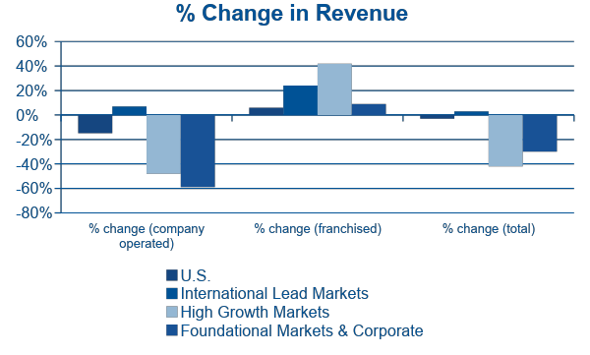
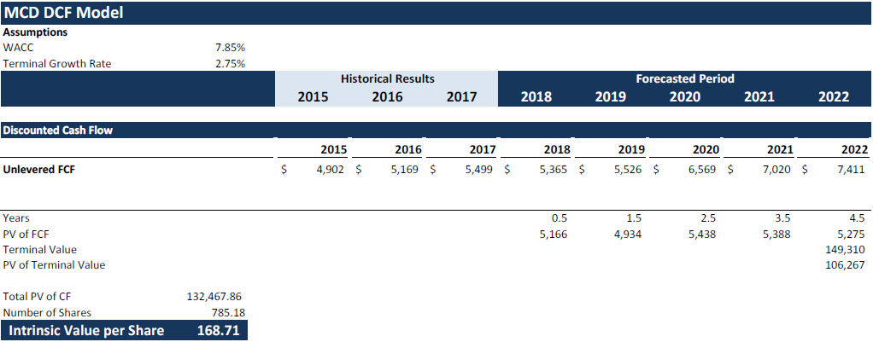
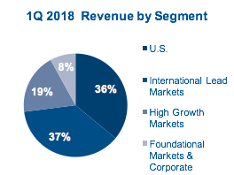
Company Details / DCF Valuation
McDonalds Corp.
NYSE MCD-US
MCD is one of the world’s leading quick service restaurant brands with 37,286 locations in 120 countries
90%+ privately owned, culturally integrated franchise locations worldwide (34,279 franchised, 3,007 owned)
Q1 2018: goal is to be 95% franchised (lowers costs & drives margins)
Customer base is structured into 4 segments that combine similar markets
Revenue decreased 9% because of refranchising in most recent quarter
DCF based on sellside research forecast suggests an intrinsic value per share of $168.71
_______________________
Source: McDonald’s Company Reports 8K & 10K, Bloomberg Data
Notes:
-Like a collection of small businesses
-Local integration: culturally relevant marketing, inspiration from local cuisine, etc.
-About 8% company owned, 92% franchised
-Ray Kroc famously said, "We are in the real estate business; not the hamburger business."

Slide 5
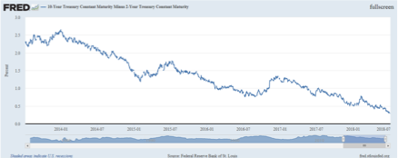
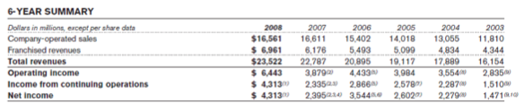
Economic Outlook
McDonalds Corp.
NYSE MCD-US
A recession is near (12-18 months)
Wage increases are squeezing revenues
Yield Curve to be inverted in 6-12 months
Inflation rates will soon overcome wage growth
Economy starting to feel effect of trade wars
Real Estate supply and demand mismatch
Oil price increases
Fed likely to increase rates more than expected to cool down economy
McDonalds has performed historically well during recessions
McDonalds net growth in 2008 was greater than that in 2006 and 2007.
Opened 600 new restaurants in 2008
Free customer acquisition: Mcafe and value menu regain popularity

Slide 6
Key Risks
McDonalds Corp.
NYSE MCD-US
Key Risks:
Grocery Deflation
As labor costs rise, grocery prices decreases.
Rising Labor Costs
Minimum wage increases apply constant pressure to McDonald's operating margins.
Labor strikes and protests
Declining Retail Traffic
Rise of E-commerce and online food ordering
Guest Count rose by 1.5% in Q4 2017, 1.9% annual
First full year of positive guest count growth since 2012
Investing heavily in mobile ordering technology
Appeases to drive-thru and stay-at-home consumers
Reputation
General move towards healthier diets
Concerns about food quality and employee treatment
Currency
40% of its debt is denominated in foreign currency
65% in Euro, Australian Dollar, British Pound, and Canadian Dollar
Management estimates a $0.25 change in earnings per share if any of the currencies moved 10%
KEY RISKS

